Slide 1

What Keeps Them Coming Back
Team Mu: Lydia Zhao, Stephen Blotkamp, Miranda Zhao, Joshua Swerdlow

Slide 2
First outlook on data set
High level Claims
Yes
Admitted into the hospital
Patient check in
Need higher
Level of care?
Doctor Visit
No
Discharged
Primary Care Physician Visit
Low level Claims

Slide 3
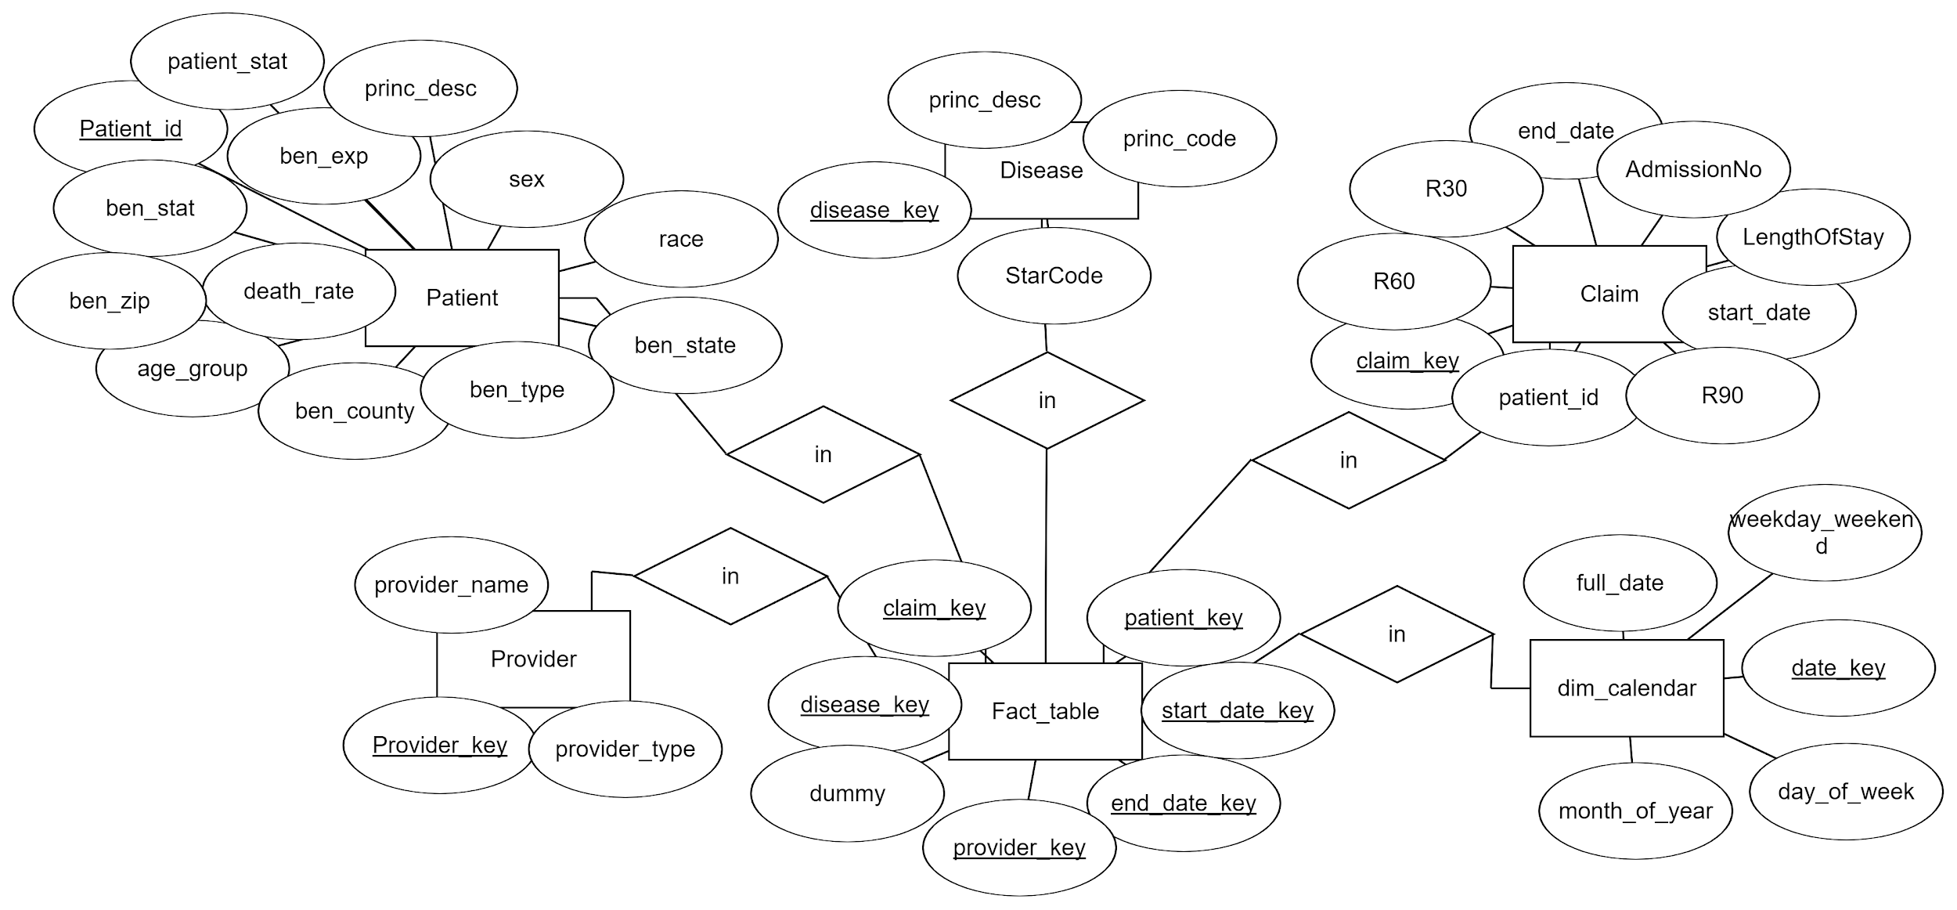
ER Diagram

Slide 4
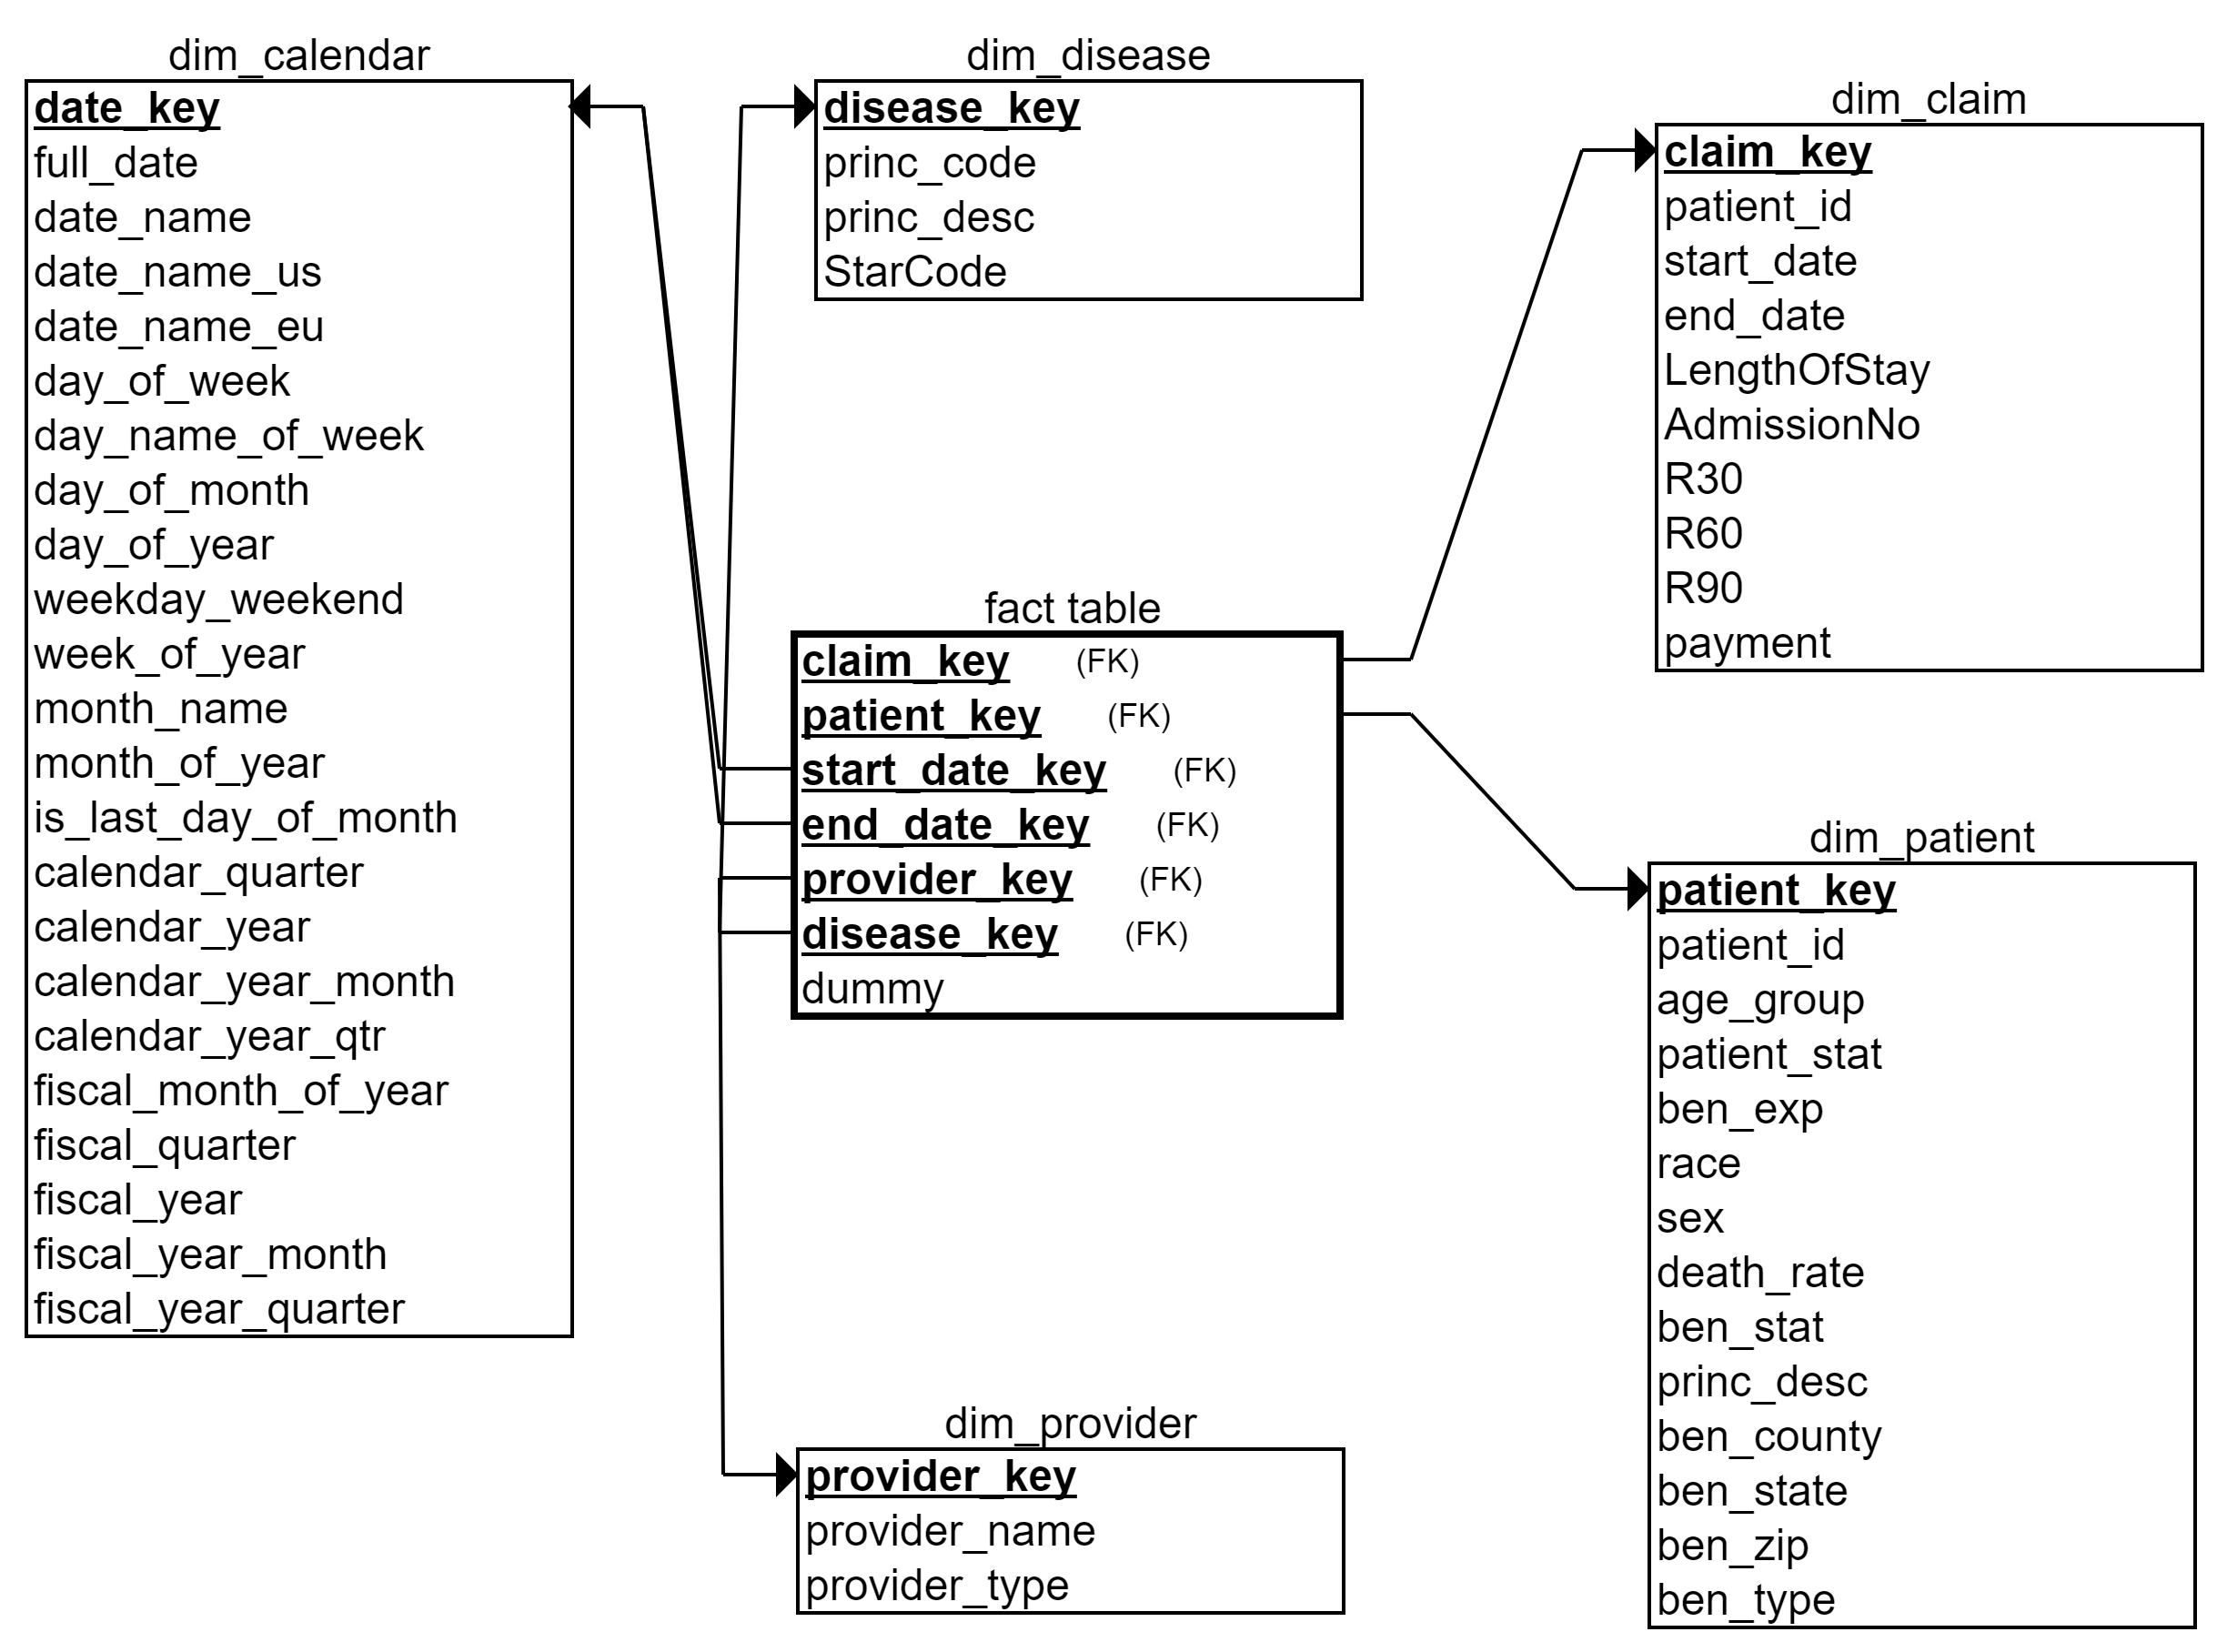
Star Schema

Slide 5

Our Questions
Does the type of disease affect the readmission rate of the patients?
Does any characteristics of the patient affect the admission rate for the 30-day period, 60-day period and 90-day period?

Slide 6
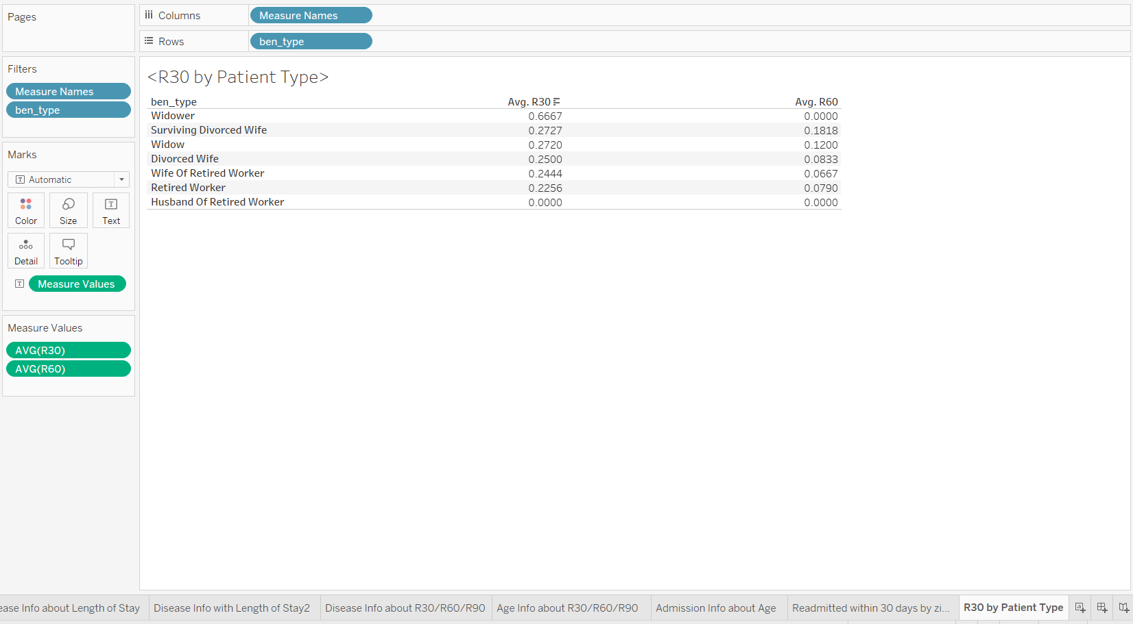
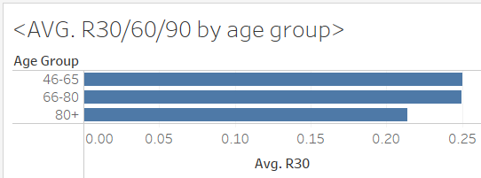
Answers to the previous questions
Patients who live alone are more likely to be readmitted in 30 days.
Patients in age groups 46-65 and 66-80 are more likely to be readmitted in 30 days, but this slight difference could be due to sample size and variance.

Slide 7
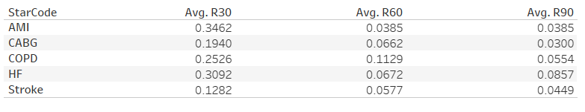
Answers to the previous questions
Patients having AMI have the highest readmission rate in 30 days.
Patients having HF have the highest readmission rate in 90 days.

Slide 8
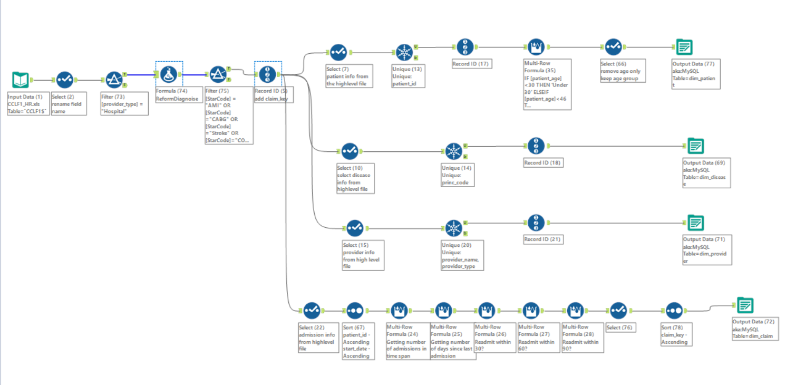
ETL -- Alteryx

Slide 9
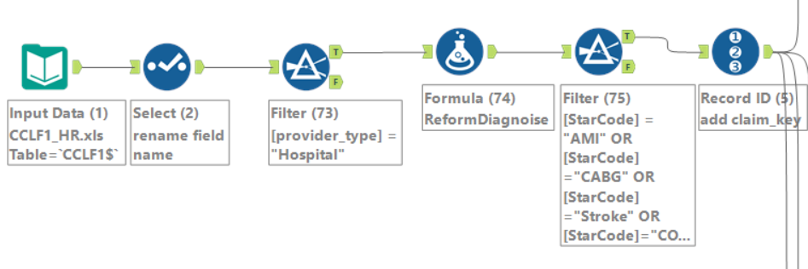
ETL- Alteryx
Data Selecting

Slide 10
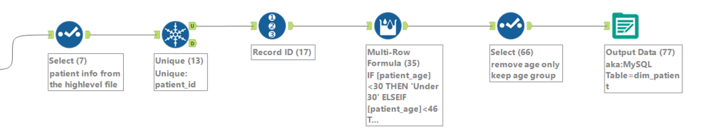
Patient Dimension

Slide 11
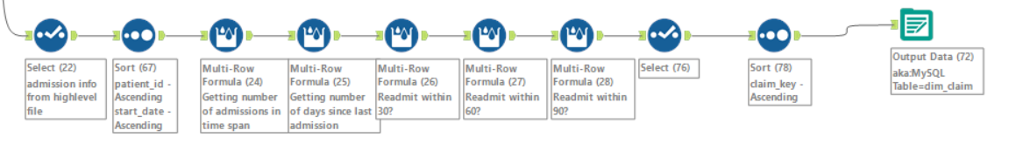
Claim Dimension

Slide 12
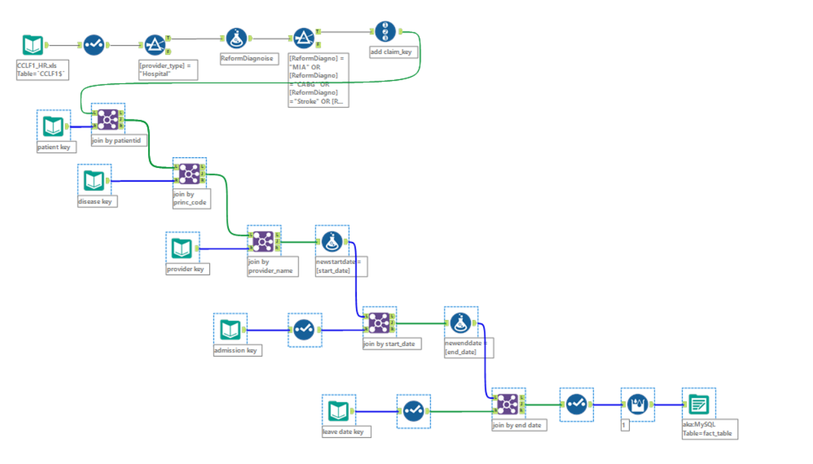

Slide 13
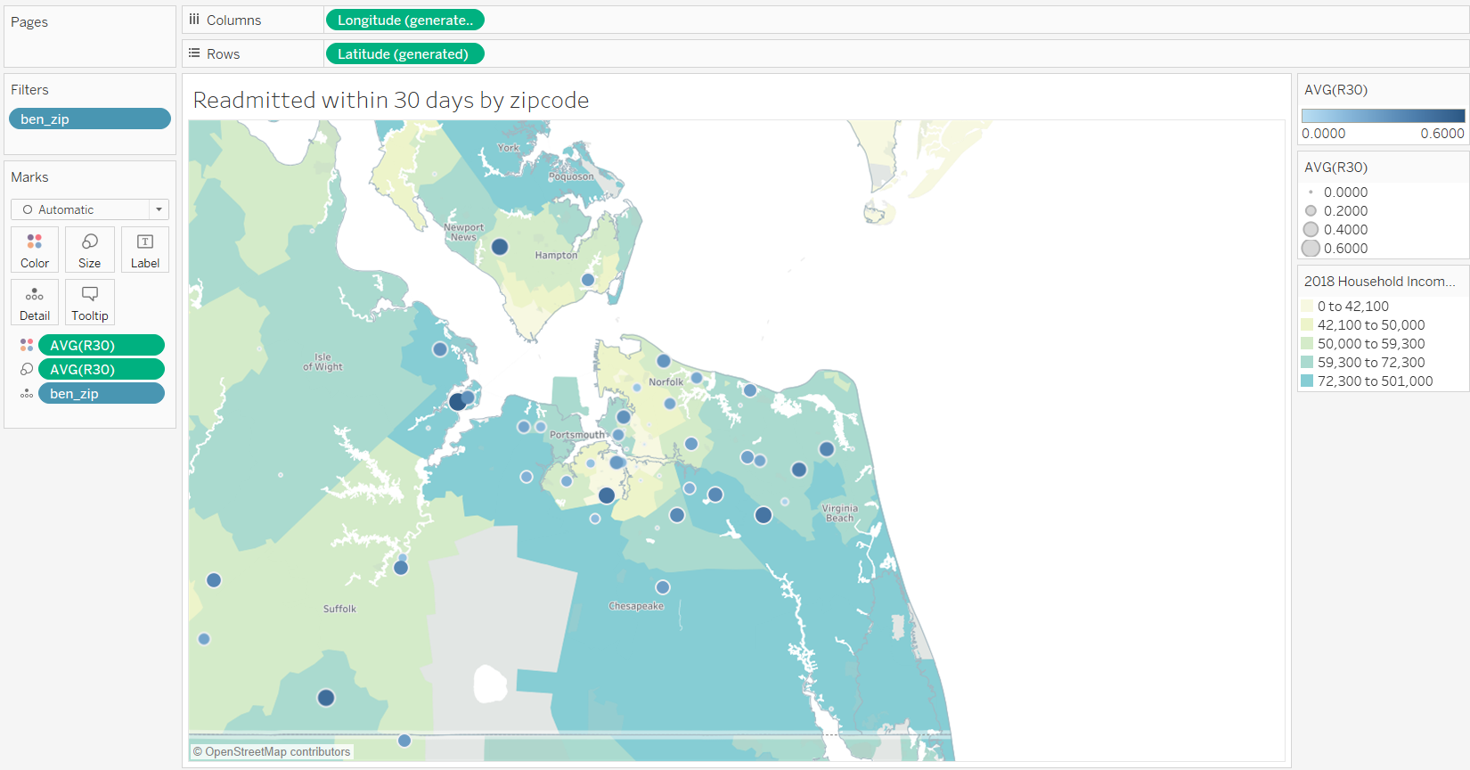
Readmission rate in 30 days by zip code

Slide 14
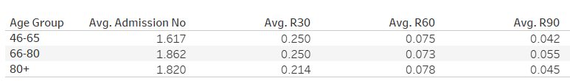
Readmission rate by age group

Slide 15
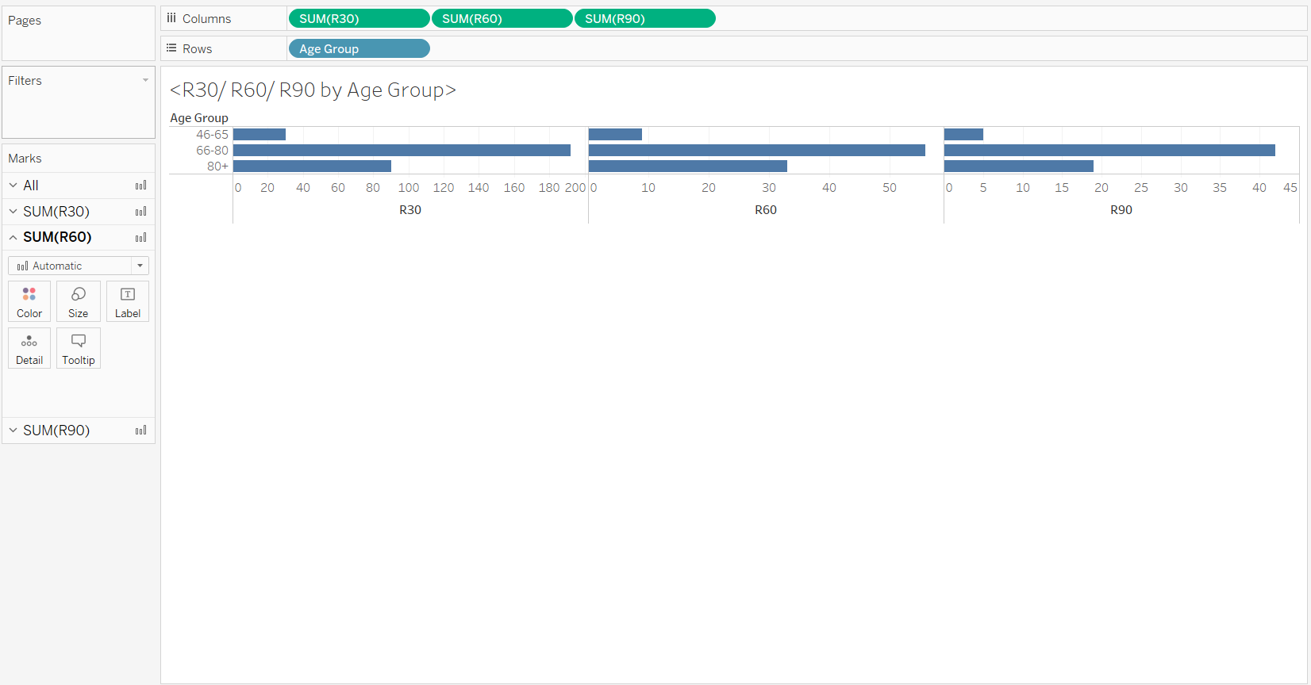
Times of readmission by age group

Slide 16
Readmission rate by patient type

Slide 17
Readmission rate by disease type

Slide 18
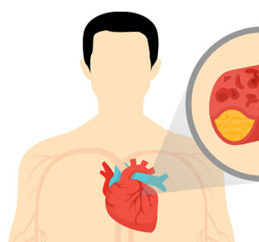
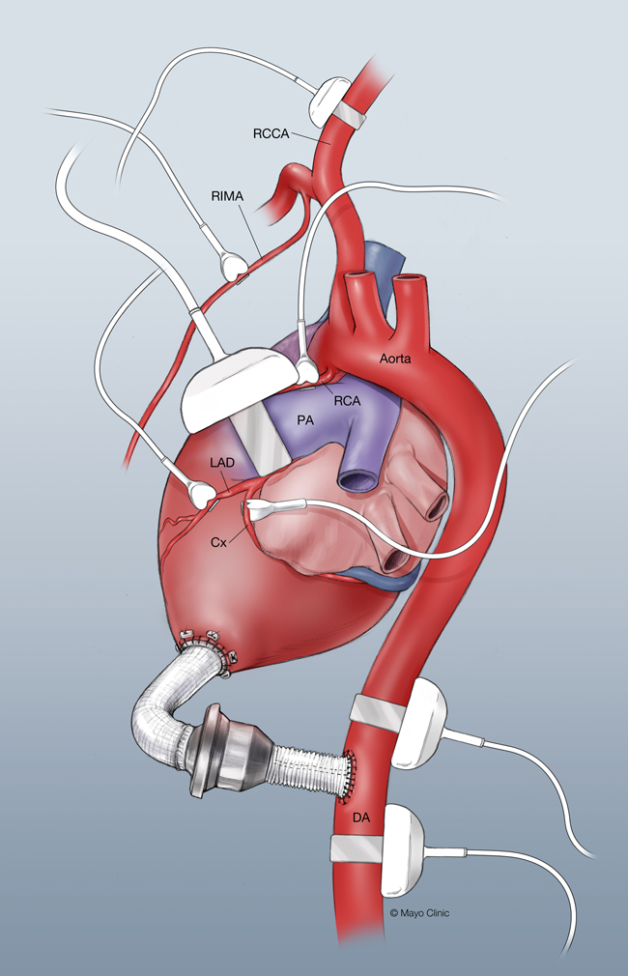
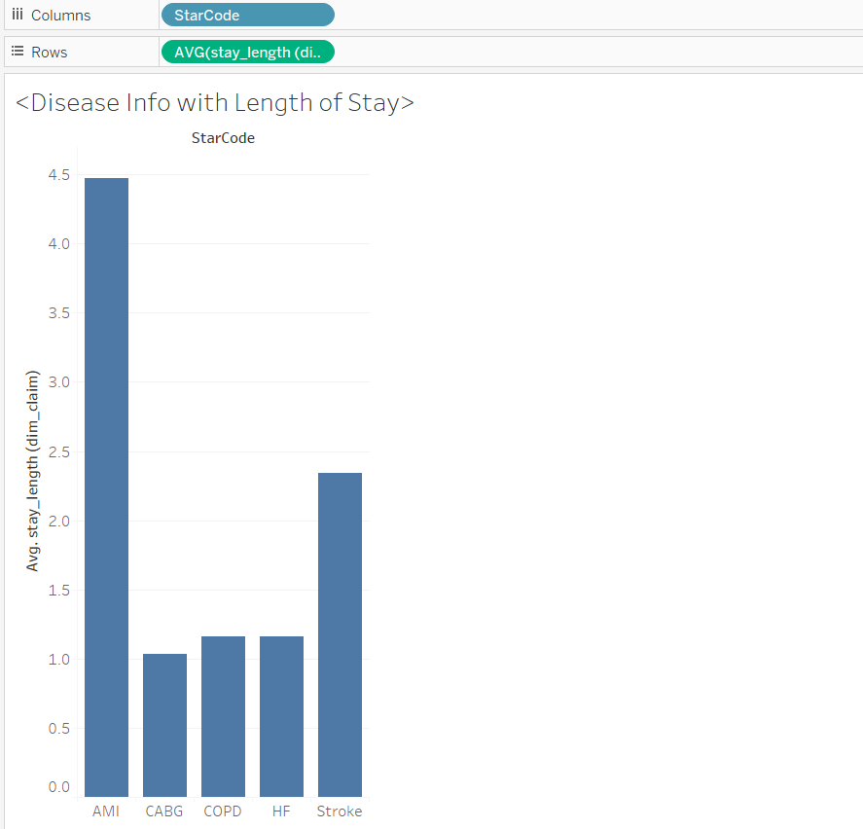
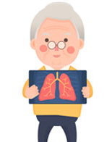


Disease Information - Length of Stay
Disease Info - Length of Stay
AMI
CABG
COPD
HF
STROKE

Slide 19
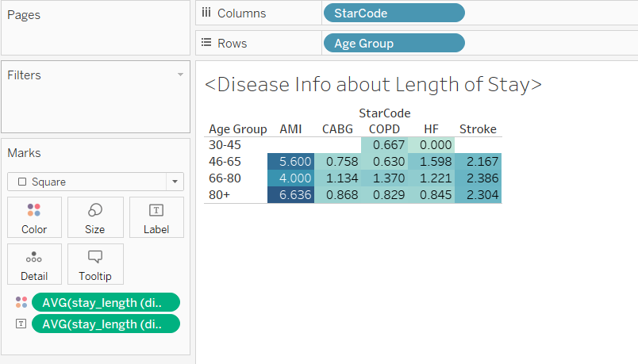
Disease Information - Length of Stay
AMI
CABG
COPD
HF
STROKE

Slide 20
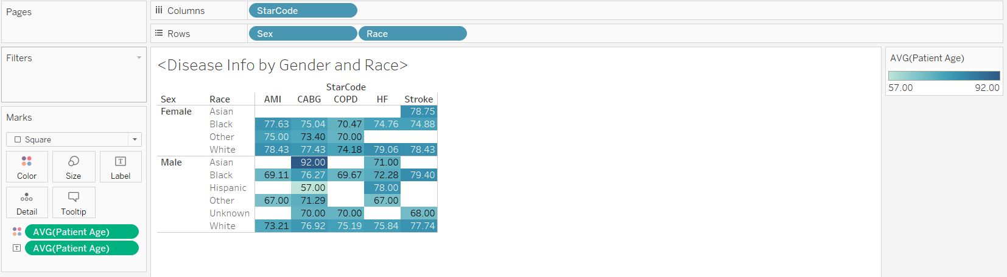
Disease Information - Patient Age (Gender and Race)
AMI
CABG
COPD
HF
STROKE

Slide 21
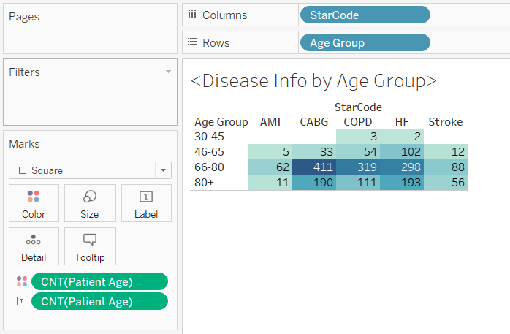
Disease Information - Patient Number
AMI
CABG
COPD
HF
STROKE

Slide 22
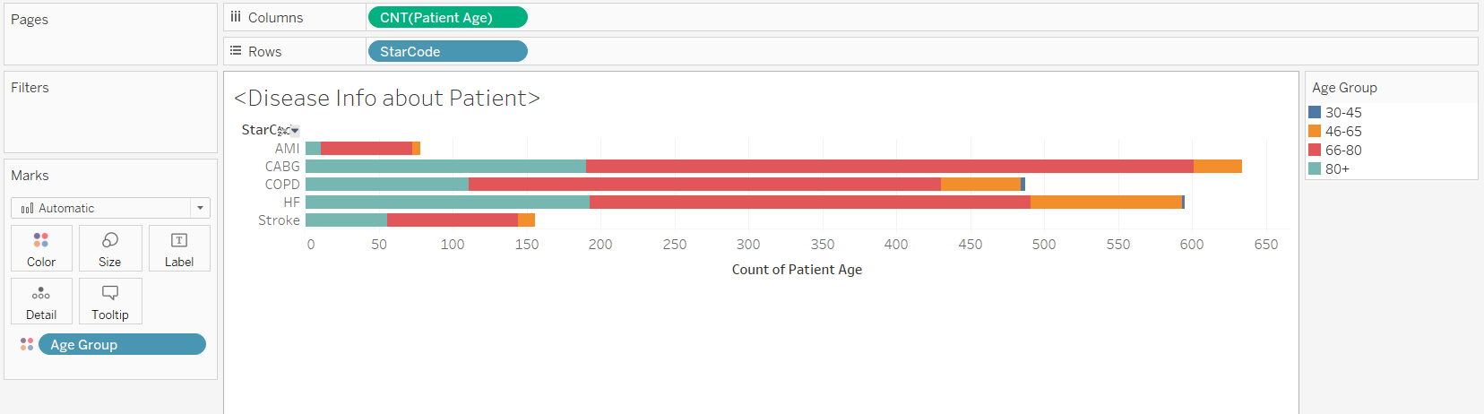
Disease Information - Disease Incidence

Slide 23
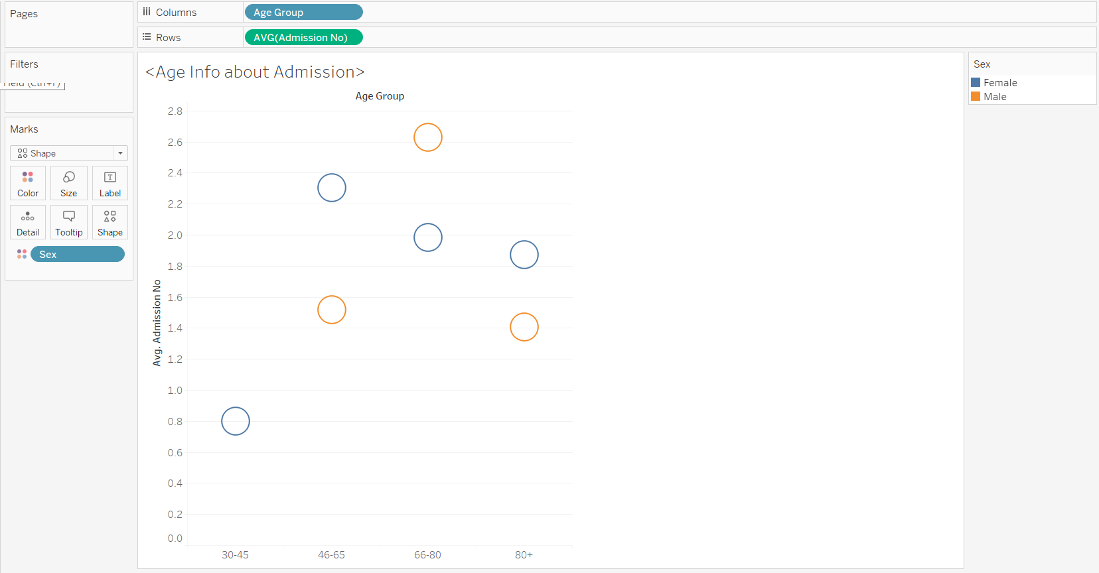
Disease Information - Admission Rate (age)

Slide 24
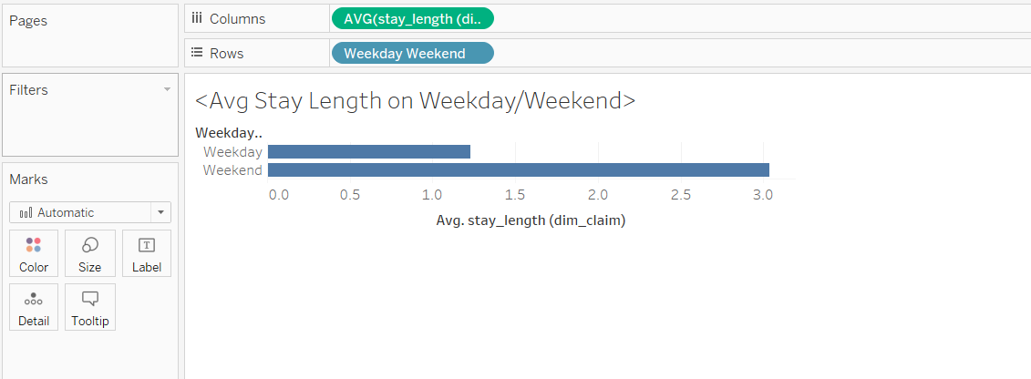
Patient Information - Length of Stay (Weekday/Weekend)

Slide 25
Description/Justification of our modeling
Dimensional modelling
Easier to retrieve information and generate reports
Easier to identify and describe when/where/who and what of the business process
Use of factless fact table
Easy to use, capture information from each dimension

Slide 26

Not Fun
Understanding and Cleaning Data
Disease Code Searching Method
Creating complex row formulas for new measures.
Fixing both technical and data processing issues

Slide 27

That was easy
Calculating the R30, R60, R90
Thinking of research questions
The queries in Tableau
Exploring data in Tableau

Slide 28
Didn’t see that coming
Clean ERD before alteryx
How messy Health care data would be
Unexpected issues of connecting Alteryx to MySQL database
There is money to be made here
Moral ethics

Slide 29
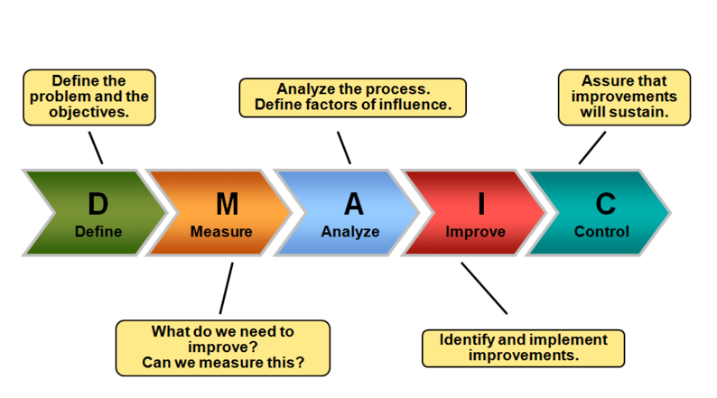

No Regrets
Overthinking it
Prioritized
Lean
Consultation

Slide 30
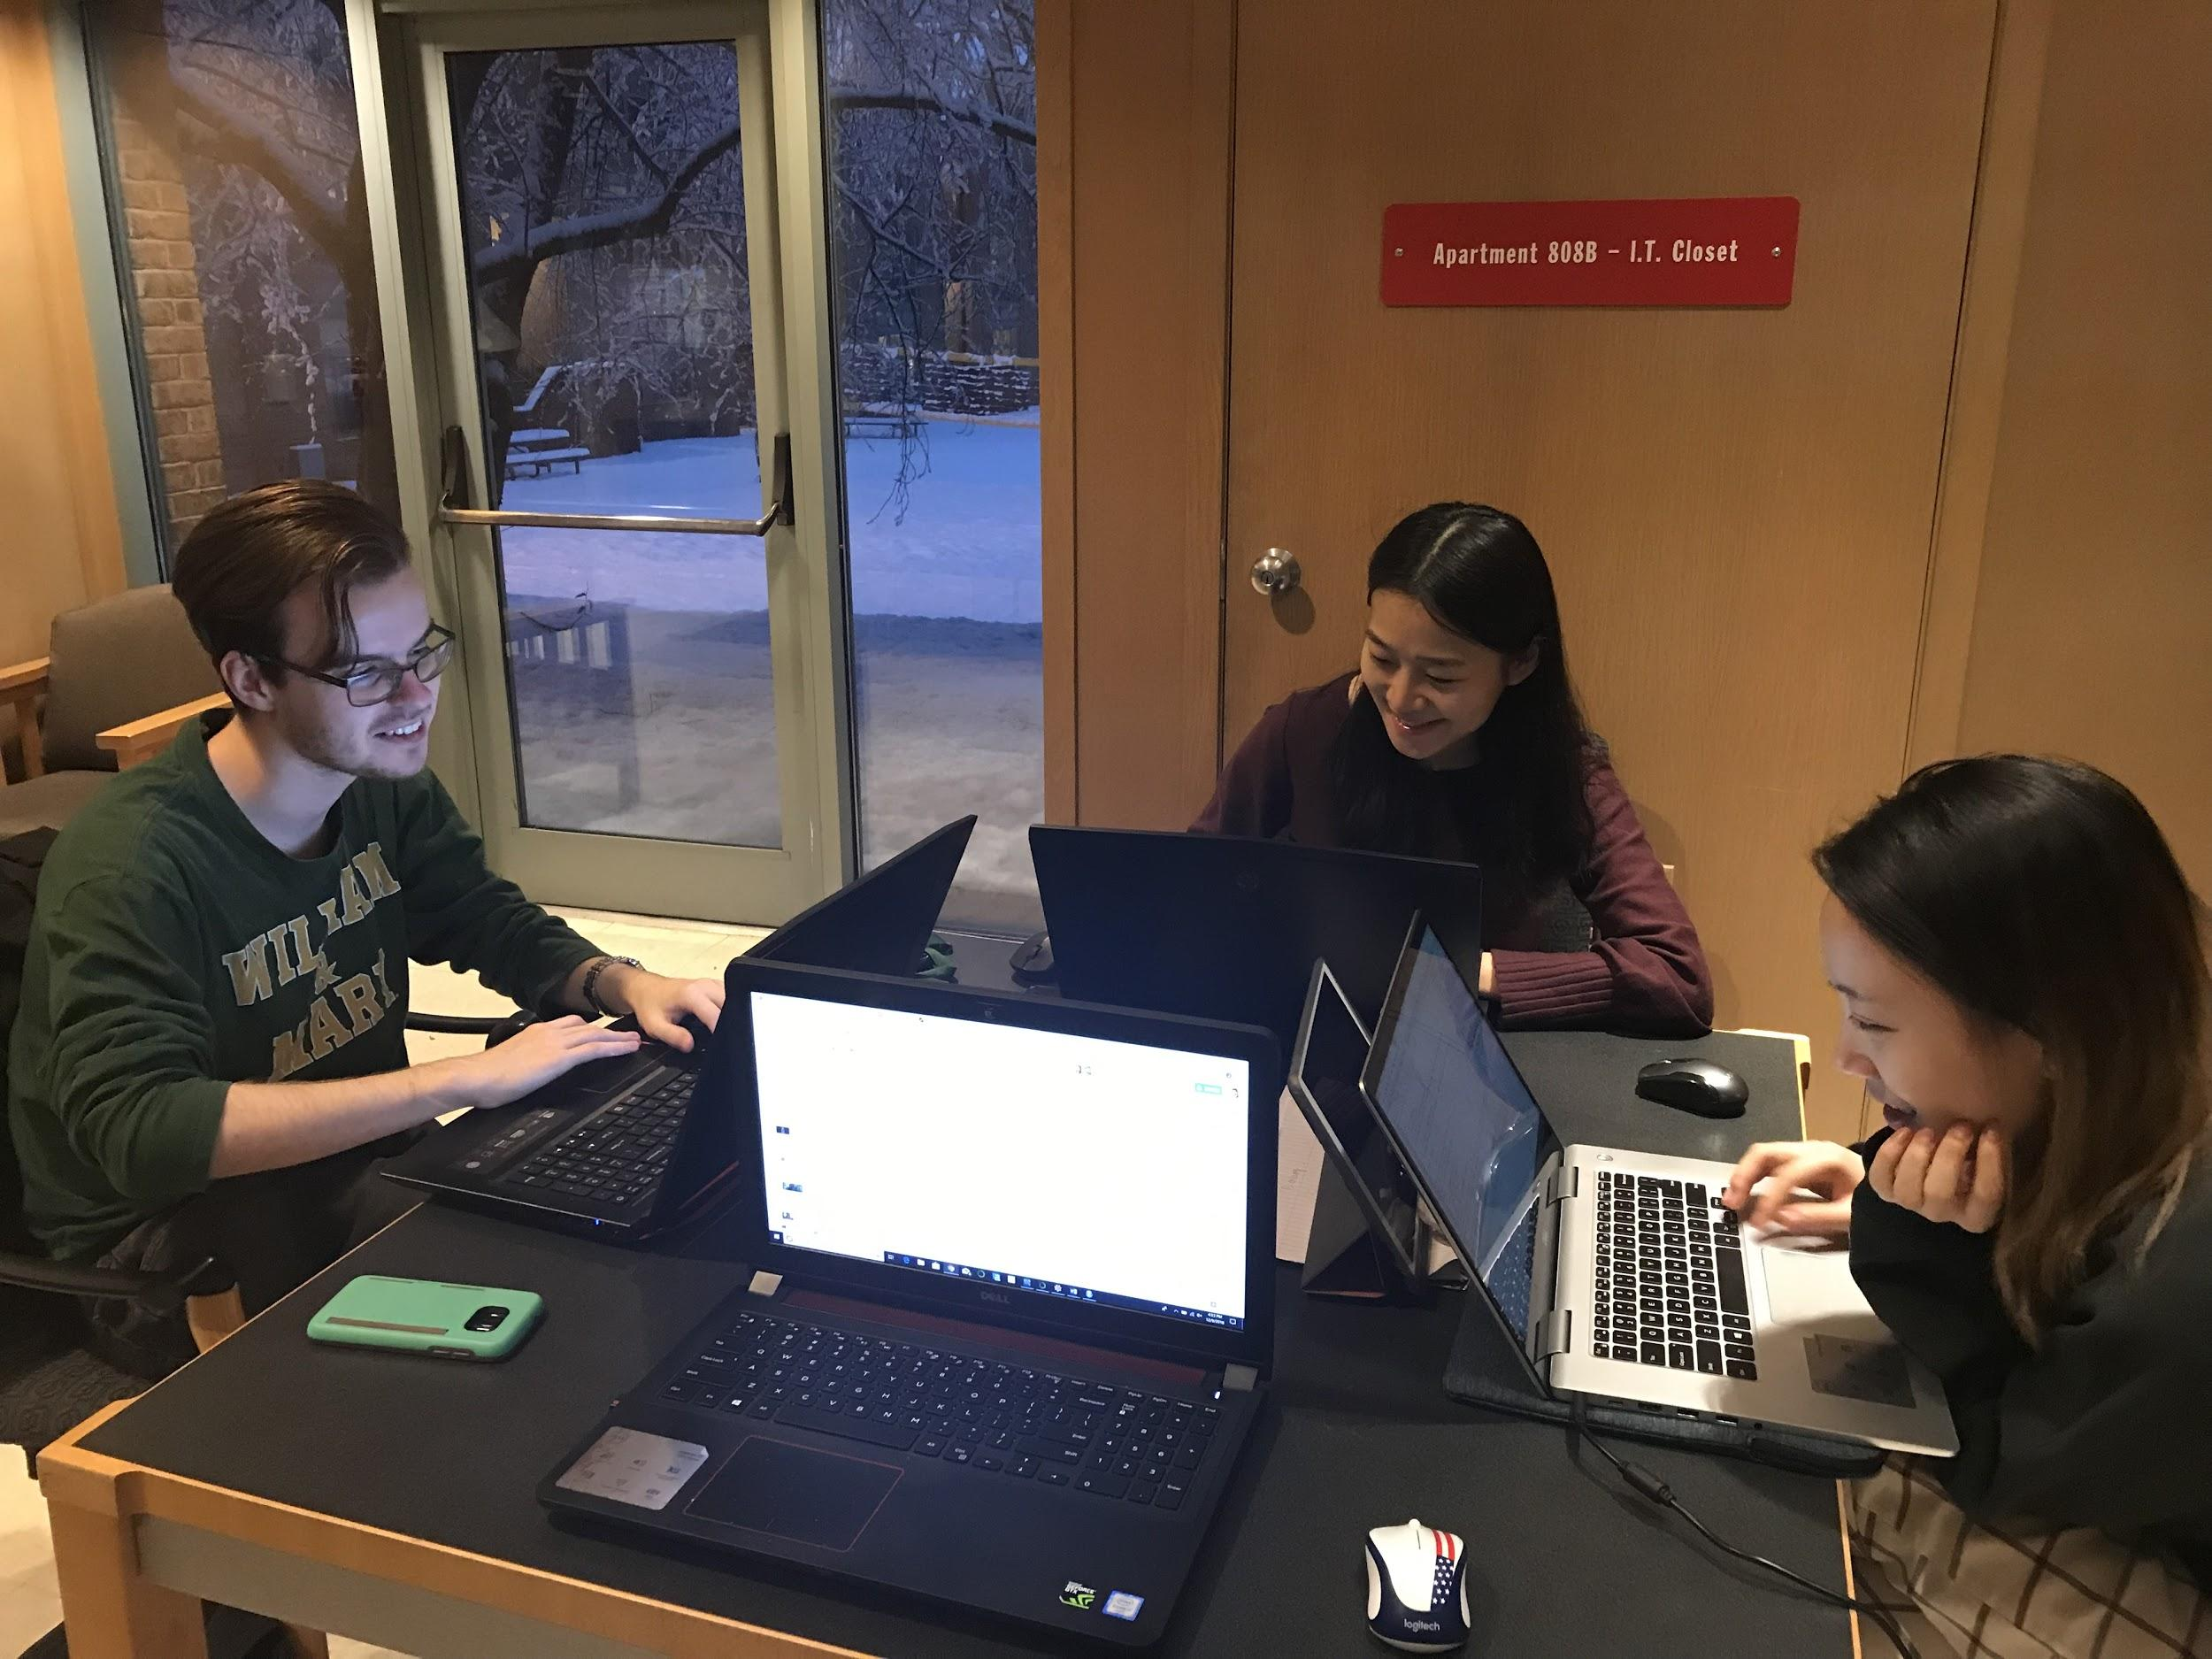
Behind the code

